Slide 1


Saving Mechanism
DavWorkx Asia
What does the bible say about saving money?
Reference:
https://get.tithe.ly/blog/bible-verses-about-saving-money

Slide 2

About Me
I am NOT:
Financial Adviser
A Wealthy Person
I don’t have
Big Savings
I will NOT
Give you money
2014 – BS in Computer Engineering
2019 – MEng in Computer Engineering
LESTER DAVE L. PELIAS
Notes:
Came from a poor family
-share experience here

Slide 3

How many of you has savings?

Slide 4

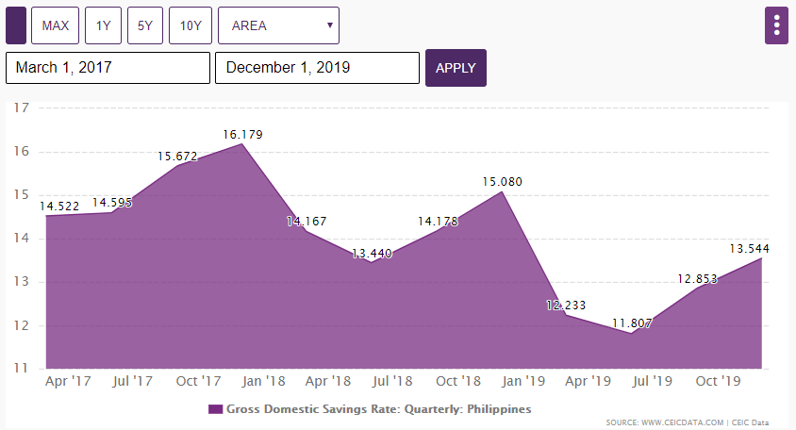
Philippines's Gross Savings Rate

Slide 5
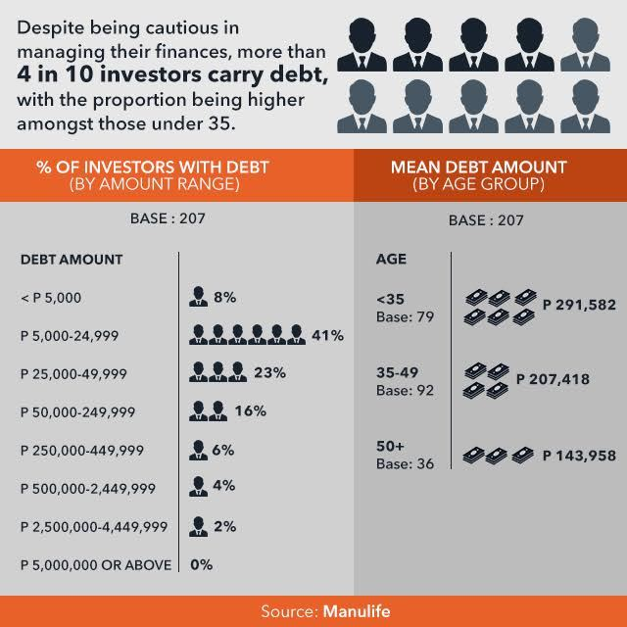
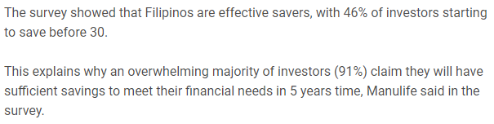
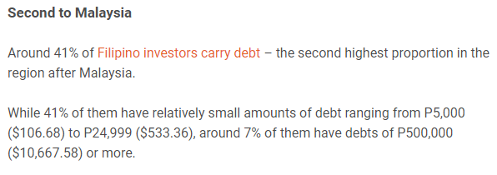
Filipinos good short-term savers, but rank high in debt – poll
https://www.rappler.com/business/industries/209-banking-and-financial-services/124948-filipinos-debt-asia-manulife-survey

Slide 6
How many of you has savings?
Notes:
Ask them , why they don’t have

Slide 7

10 Reasons Why You Can’t Save Money

Slide 8

Lifestyle
You keep upgrading your lifestyle
You procrastinate
Notes:
2. There’s a reason why “pay yourself first” is a golden rule of personal finance. It’s because if people don’t set aside money right away, most won’t do it at all. The general idea is this: Take a certain percentage of your paycheck, and allocate it to savings. And the remainder is what you’ll be left with to use for bills and other expenses.
Bad savers are often procrastinators, so they continuously tell themselves they’ll save later. To take the pressure off, these kinds of consumers can benefit from setting up automatic withdrawals each month. This gives you no choice but to save, so you can stop making excuses to put it off again and again.

Slide 9

Lifestyle
3. You think saving is lame
4. You’re afraid of money
Notes:
3. Bad savers sometimes claim they like to “live in the now,” rather than prepare for the future. Do you ever feel like you are stuck in the present? It’s often a lot less glamorous and exciting than it sounds. You can’t have much fun living in the present moment if your present always feels like you are running out of money.
Savers are actually better equipped to take the occasional spontaneous trip or adventure because they don’t have to wait for their next paycheck every time they want to do something fun. Instead of focusing on what you want in the here and now — and being disappointed when you can’t afford it — start thinking about what you really want. If you can see past your immediate desires, your bigger goals will start to motivate you. Then, you’ll see saving isn’t a chore at all. It’s your ticket to financial freedom.
4. A lot of people are afraid of not having enough money, but there are some who have the opposite problem. If you’re afraid of amassing too much wealth, it will be important for you to dig deep and find out why. Meeting with a therapist can help you uncover why you have a fear of obtaining financial success. One way this fear of money can manifest is through underearning. Financial educator Barbara Stanny addresses this issue in her book

Slide 10

Lifestyle
5. You’re too nice
6. You have bad habits
Notes:
5. Do you freely lend money to anyone who asks? If you’re the family ATM, this behavior needs to stop. It will be difficult to save money if you don’t keep some of it in your bank account. Work to get over your fear of being seen as the bad guy, and practice saying “no” every now and then. Don’t agree to lend money if it would put your financial future at risk.
Also, remember your relationships could be at risk if the loan isn’t repaid (which is likely). A money etiquette survey revealed 57% of people said they have witnessed the breakdown of a friendship or some other close relationship because one person didn’t pay back the other.
6. Your habits determine the quality of your life. This applies not only to your professional life but your personal life, as well. The ability to save money doesn’t just happen overnight. It’s a habit that must be developed over time. Until you learn how to consistently save money each pay day, you’ll continue to struggle. One great way to get started is to automate your savings.

Slide 11

7. You don’t have support
8. You compare yourself
Notes:
If you spend time with people who aren’t good at money management, their bad habits could eventually rub off on you. And if you’re a saver and you happen to marry a spender, you’re in for a lot of marital conflict down the road. Make an effort to keep company with friends and family members who respect money. Also, consider appointing someone to become an accountability partner. This way, when you’re tempted to overspend, you can give him or her a quick call.
Comparing yourself to your neighbors or acquaintances is normal, but frequently engaging in this behavior could lead you to make some very poor financial choices. For example, if you always see others dressed well, this could cause you to feel like you don’t look good enough. You might start spending money you don’t have on new clothes, so you can fit in and look nice. However, those credit card purchases will catch up to you, and you’ll be left with a bill you can’t pay.

Slide 12
9. You don’t have financial goals
10. You’re not motivated
Notes:
Before you can take a step forward, you need to know where you’re going. Progressing financially will require you to set and keep money goals. If you want to reach those goals, you need to consistently remind yourself of where you want to be in the next few years. Keep your eye on the prize by creating a financial vision board. Keep the board next to your bed, so you’ll be consistently reminded of what you’ve been working so hard to achieve.
If life has been going smoothly, you probably don’t think much about saving cash. However, life is unpredictable. A major emergency could knock you right off your feet. All it takes is an unexpected illness, a divorce, or a sudden death to change your financial circumstances overnight. If you can’t seem to get motivated, think about what your life would be like without an extra cash cushion.

Slide 13

What does the bible say about saving money?
Notes:
There are many Bible verses about saving money full of practical advice. You're not going to find a hidden secret to saving or investing money you can unlock to gain untold riches. But you’ll learn everything you need to know and more to manage your money well.
We put together 20 scriptures on saving money that will guide you in your finances.

Slide 14

Proverbs 3:5-6:
"Trust in the LORD with all your heart, and do not lean on your own understanding. In all your ways acknowledge him, and he will make straight your paths.”
Proverbs 21:5:
"The plans of the diligent lead surely to abundance, but everyone who is hasty comes only to poverty.”
Proverbs 24:27:
"Prepare your work outside; get everything ready for yourself in the field, and after that build your house.”
#1. Plan for your future
Notes:
In Genesis 41:34-36, we read, "Let Pharaoh proceed to appoint overseers over the land and take one-fifth of the produce of the land of Egypt during the seven plentiful years. And let them gather all the food of these good years that are coming and store up grain under the authority of Pharaoh for food in the cities, and let them keep it. That food shall be a reserve for the land against the seven years of famine that are to occur in the land of Egypt, so that the land may not perish through the famine.”
In this passage, God revealed to Joseph that Egypt was going to experience a significant famine. The availability of food was going to be scarce, and, if they didn’t plan for this event, the people of Egypt would starve.
God will most likely not provide you with such a clear picture of your future like he did for Joseph and Egypt. But what we see in Bible verses about saving money is God’s will for us to save for our future, which includes expenses we should expect, like college and retirement, as well as costs we didn’t plan for, like a car breaking down or fixing a leak in your house’s roof.
To help you prepare for your future, here’s what the Bible says about saving money and planning:
Proverbs 3:5-6:
"Trust in the LORD with all your heart, and do not lean on your own understanding. In all your ways acknowledge him, and he will make straight your paths.”
Proverbs 6:6-8:
"Go to the ant, O sluggard; consider her ways, and be wise. Without having any chief, officer, or ruler, she prepares her bread in summer and gathers her food in harvest.”
Proverbs 13:16:
"Every prudent man acts with knowledge, but a fool flaunts his folly.”
Proverbs 21:5:
"The plans of the diligent lead surely to abundance, but everyone who is hasty comes only to poverty.”
Proverbs 24:27:
"Prepare your work outside; get everything ready for yourself in the field, and after that build your house.”
Luke 14:28:
"For which of you, desiring to build a tower, does not first sit down and count the cost, whether he has enough to complete it?”
Philippians 4:6:
“Do not be anxious about anything, but in everything by prayer and supplication with thanksgiving let your requests be made known to God.”

Slide 15
Proverbs 10:4-5:
"A slack hand causes poverty, but the hand of the diligent makes rich. He who gathers in summer is a prudent son, but he who sleeps in harvest is a son who brings shame.”
Proverbs 21:5:
"The plans of the diligent lead surely to abundance, but everyone who is hasty comes only to poverty.”
#2. Be diligent
Notes:
Saving for your future doesn’t happen by accident.
If you have a fever to save money, you don’t need more cowbells.
What you need is diligence.
In other words, you not only need to make a plan to save for the future, but you have to work your plan consistently. Basically, you have to cut expenses and set aside money in some sort of fund.
In Bible verses about saving money, God often contrasts diligent people with lazy people.
In general, the diligent person—who we should exemplify—is spoken of favorably by God and is the person who gets ahead financially.
When it comes to talking about laziness, God doesn’t mince words. What we’ll observe in the scriptures about saving money below, God uses strong words to confront people who struggle with being idle, and he lets it be known that not working is one sure way you’ll end up in poverty.
Proverbs 10:4-5:
"A slack hand causes poverty, but the hand of the diligent makes rich. He who gathers in summer is a prudent son, but he who sleeps in harvest is a son who brings shame.”
Proverbs 21:5:
"The plans of the diligent lead surely to abundance, but everyone who is hasty comes only to poverty.”

Slide 16

Proverbs 13:11:
"Wealth gained hastily will dwindle, but whoever gathers little by little will increase it.”
Proverbs 28:20:
“A faithful man will abound with blessings, But whoever hastens to be rich will not go unpunished."
1 Corinthians 16:2
"On the first day of every week, each of you is to put something aside and store it up, as he may prosper, so that there will be no collecting when I come."
#3. Save consistently
Notes:
One key found in Bible verses about being smart with money is consistency.
When it comes to saving money, consistently setting aside something every month (even if you think it’s little) can lead you to reap huge benefits in the future—especially if you start at an early age—thanks in large part to something that’s called compound interest.
As you prepare to save, feel free to start small. Fight the pressure of making big changes or not feeling like you should save at all if you can't set aside as much as you would like.
Proverbs 13:11:
"Wealth gained hastily will dwindle, but whoever gathers little by little will increase it.”
Proverbs 28:20:
“A faithful man will abound with blessings, But whoever hastens to be rich will not go unpunished."
1 Corinthians 16:2
"On the first day of every week, each of you is to put something aside and store it up, as he may prosper, so that there will be no collecting when I come."

Slide 17

Proverbs 21:20:
"Precious treasure and oil are in a wise man’s dwelling, but a foolish man devours it."
Proverbs 22:7:
“The rich rules over the poor, And the borrower is the slave of the lender.”
Isaiah 55:2:
“Why do you spend your money for that which is not bread, and your labor for that which does not satisfy? Listen diligently to me, and eat what is good, and delight yourselves in rich food.”
#4. Save paycheck-to-paycheck
Notes:
For some of you reading this, you may not really be able to do anything else at the moment. From just getting started in your career to simply not making enough money, there are different reasons why you have to live check-to-check and don’t have enough money leftover at the end of the month to save.
Now, for others reading this post, you’re just spending too much money. American credit card debt is more than $1 trillion, and according to one study, Americans said their worst financial habit was "spending too much on things they don’t need.”
Another essential lesson we can learn from Bible verses about saving money and Bible verses about debt is to spend less and save more. So, instead of spending paycheck-to-paycheck, make plans to save paycheck-to-paycheck.
Proverbs 21:20:
"Precious treasure and oil are in a wise man’s dwelling, but a foolish man devours it."
Proverbs 22:7:
“The rich rules over the poor, And the borrower is the slave of the lender.”
Isaiah 55:2:
“Why do you spend your money for that which is not bread, and your labor for that which does not satisfy? Listen diligently to me, and eat what is good, and delight yourselves in rich food.”
Luke 12:15:
“And he said to them, ‘Take care, and be on your guard against all covetousness, for one’s life does not consist in the abundance of his possessions.”
Romans 13:8:
“Owe no one anything, except to love each other, for the one who loves another has fulfilled the law."
Hebrews 13:5:
“Keep your life free from the love of money, and be content with what you have, for he has said, ‘I will never leave you nor forsake you.’"

Slide 18
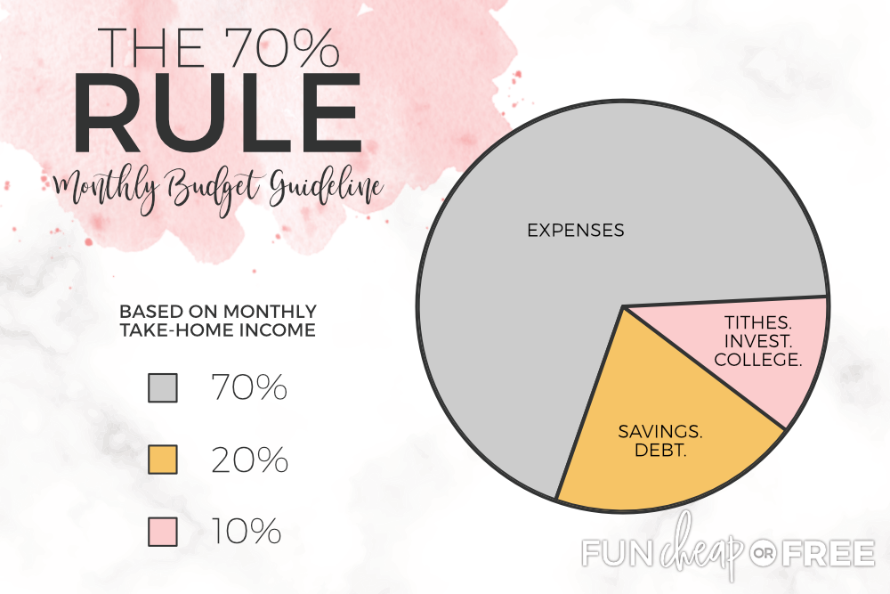
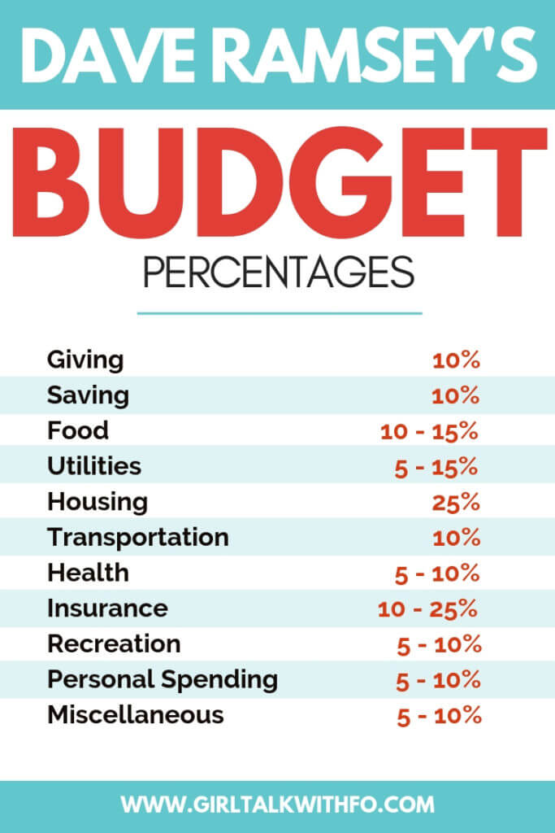
Budget Rule
Notes:
Giving 10%
Though there is no cap on how much one can give, it is important to plan for it. Giving is an act of selflessness that not only helps others, but also gives back in ways that can’t be quantified.
Giving a tenth of your income, or a tithe, is a common practice traditionally found within Christianity. Yet, it can be used as a general guideline for anyone. Whether it be to a church for religious beliefs or for philanthropy, giving should be accounted for in your budget.
Saving 10%
After paying off debt and having a fully funded emergency fund, Dave recommends setting aside 10% of your income to save for big expenses. These big expenses include saving for a car or other large purchases. At this point in your financial journey, he also recommends putting 15% toward retirement savings.
Food 10-15%
Food is an inevitable expense, however it shouldn’t take up an excessive amount in your budget. This 10-15% accounts for groceries, dining out, and fast food. If you find yourself unable to stay within this suggested range, consider meal prepping to reduce the cost of dining out.
Utilities 5-10%
Your utilities are a necessary expense that will include electricity, water, gas, and heating costs. It may also include internet, cable, and phone costs. Set aside 5-10% of your income to cover the costs, noting that these costs can fluctuate throughout the year.
Housing 25%
Your monthly housing costs should fall under a quarter of your monthly take home income. Anything more could come at the risk of not being able to cover other necessary expenses.
The housing category takes into account your monthly rent or mortgage payment, homeowners association (HOA) dues, property taxes, insurance, and PMI (if applicable). If you’re not sure how much of a total mortgage this equates to, you can use this mortgage calculator to find out.
Transportation 10%
Transportation costs may include fuel, oil changes and other maintenance, taxes, toll fees, and public transportation costs. Automobile loans may also fall into this category; however, you should allocate extra funds toward paying any car debt off.
Health 5-10%
It’s inevitable that you will incur health related expenses, so be proactive and plan for it. Set aside funds for those unexpected trips to the doctor (not covered by insurance), over the counter medicines, and that monthly gym membership.
Insurance 10-25%
Though you may already have funds taken out of your paycheck to cover your employer subsidized health insurance, there are other coverages that you must have. Auto insurance, additional health insurance, and life insurance all fall under this category.
Recreation 5-10%
The best fun is budgeted for. Plan to have a percentage of your income to go toward things like movie tickets, concerts, or perhaps a quick staycation.
Personal Spending 5-10%
Sometimes you just want to spend money on things for yourself. This category includes things like clothing, personal care, and other miscellaneous items that you choose to spend on.
Miscellaneous 5-10%
Left it off of the budget? Allocate funds to cover any missed expenses.

Slide 19


Slide 20





Thank You
DavWorkx Asia
Lester Dave L. Pelias
+63 956 694 7456
ldpelias@davworkxasia.com
http://www.davworkxasia.com/

